Slide 1
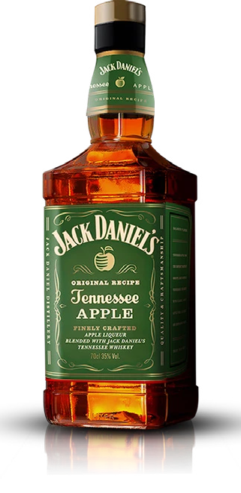
JACK APPLE HISPANIC PROGRAM
CONTENT PARTNERSHIP F22
RECOMMENDATION
2022
Notes:
Khalyn

Slide 2
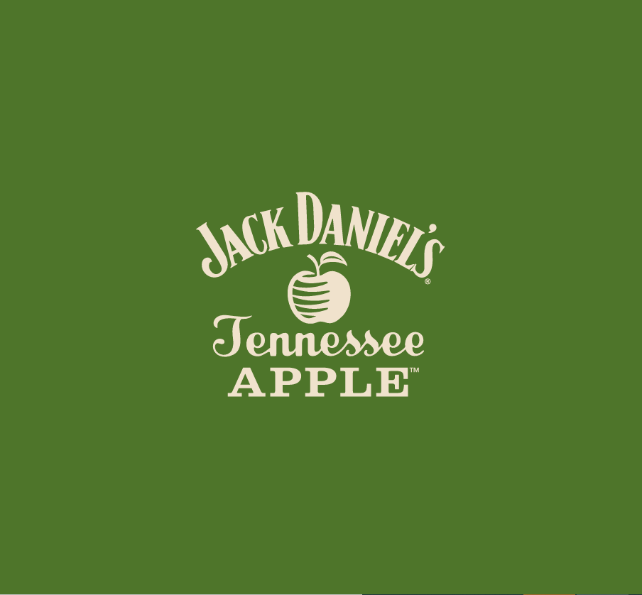
Today's Agenda
MEET
JACK APPLE (Khalyn)
CAMPAIGN 1 (Sabrina)
Activation Ideas + Media Partners
CAMPAIGN 2 (Samantha)
Activation Ideas + Media Partners
Notes:
Khalyn

Slide 3
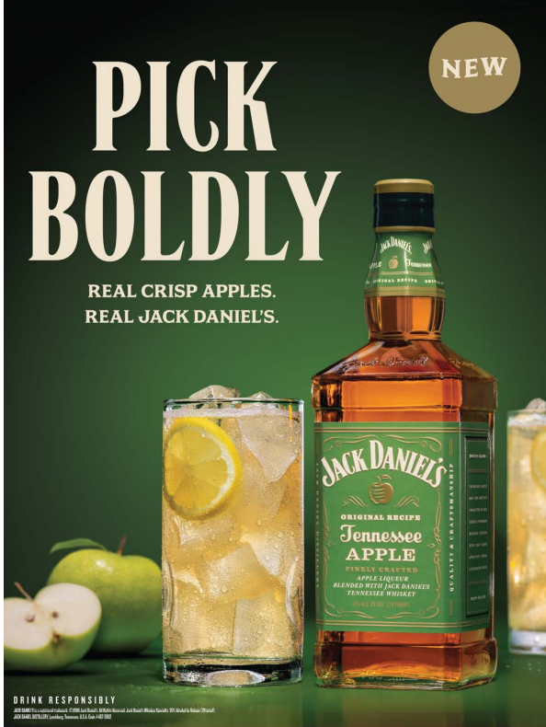
Meet Jack Apple
Brand Overview
A fresh new take on the classic Jack Daniel's whiskey, that creates the perfect drink with friends or night out on the town.
Target Demographic
Men and Women Ages 21 – 30 who are of Hispanic and Latino Descent.
Brand Goals
To engage more authentically and build better brand awareness for the Hispanic target market.
Notes:
Khalyn

Slide 4
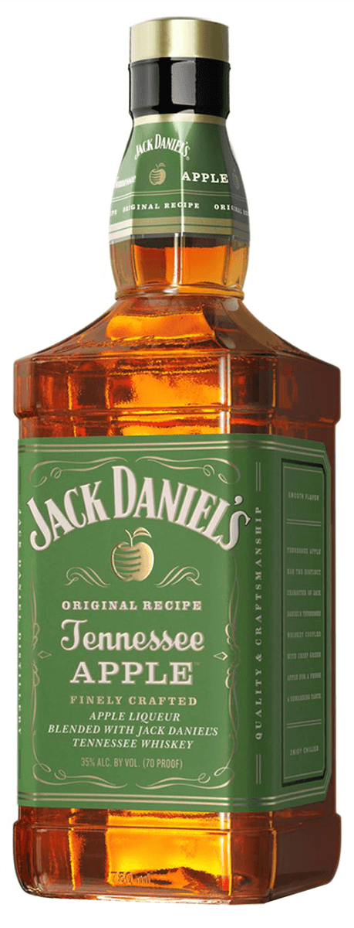
The Approach
Tap into 2 different passion points: sports and beauty
Why We Like This
Multiple Voices
Contextualize the Hispanic heritage message in different ways
Opportunity to Drive Consumer Purchasing
Influencers with highly engaged fans
Motivate fans to embrace their heritage
Custom content for an authentic feel
Notes:
Khalyn

Slide 5
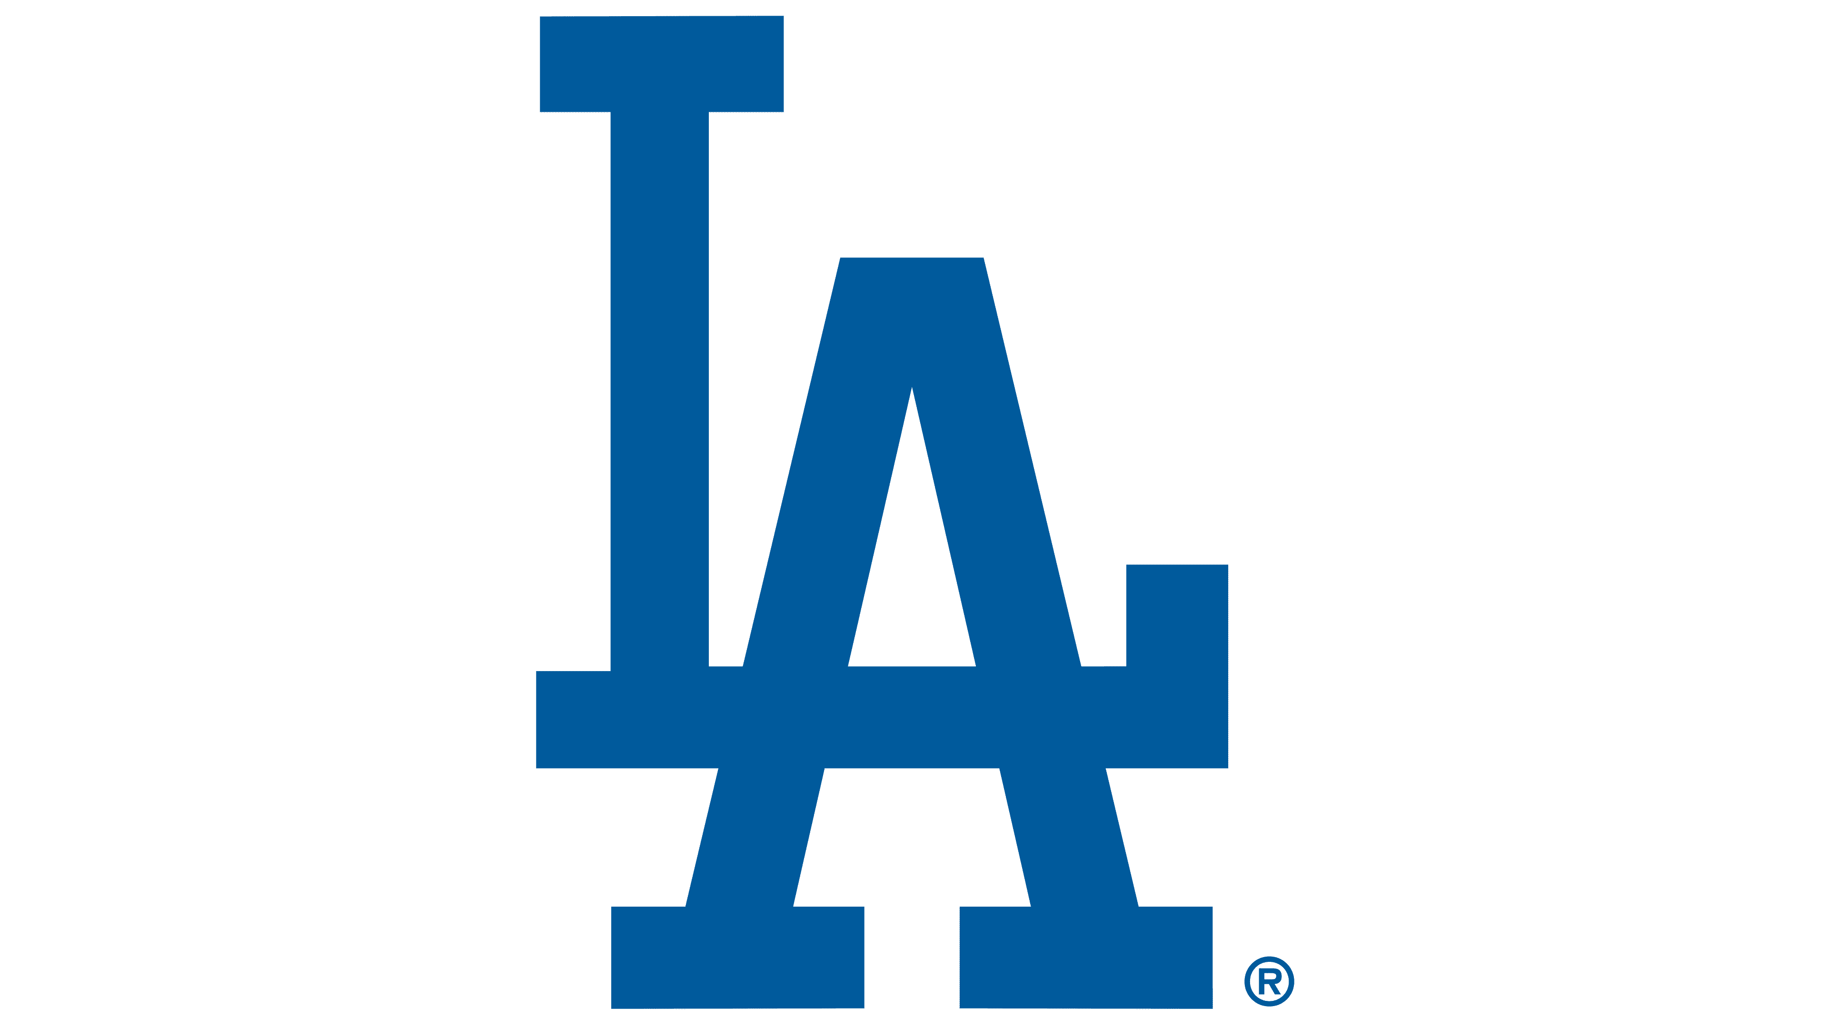
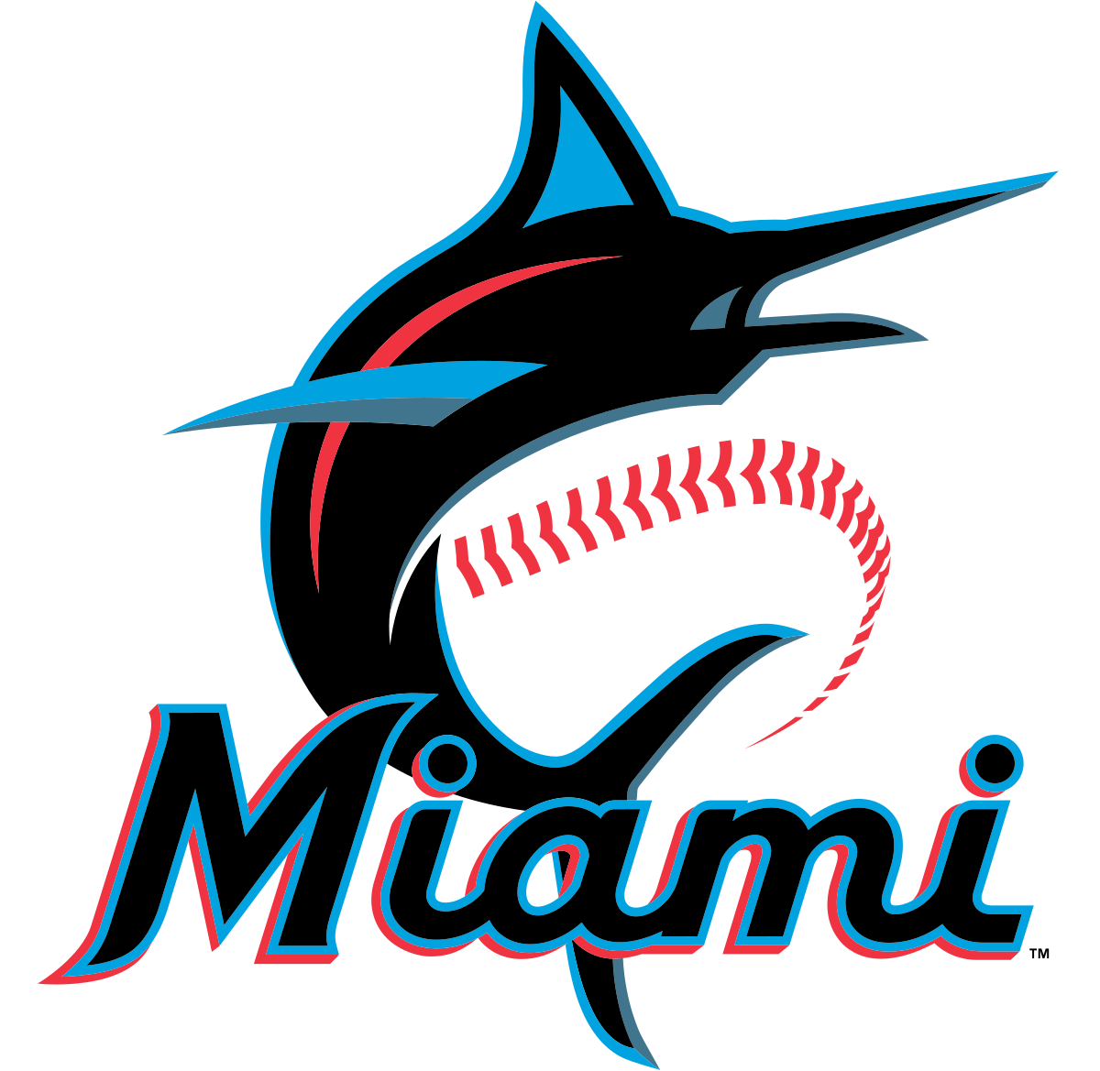
Campaign 1
Long Form Content Baseball Player Partnership + Stadium Alcohol Plus Up
Notes:
Sabrina

Slide 6
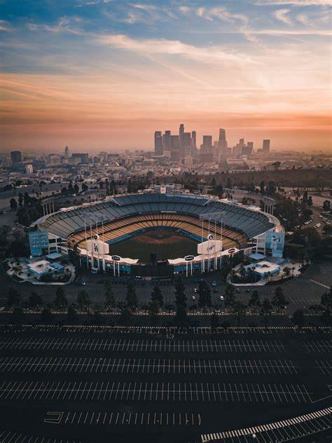
The Opportunity
Baseball Player Partnership
Plus Up: Baseball Stadium Alcohol Partnership
Long form content and short form content featuring two Hispanic Baseball players from the Los Angeles Dodgers and Miami Marlins.
Create a fun, new drink featuring Jack Apple to be sold at the player's home stadiums.
Notes:
Sabrina

Slide 7
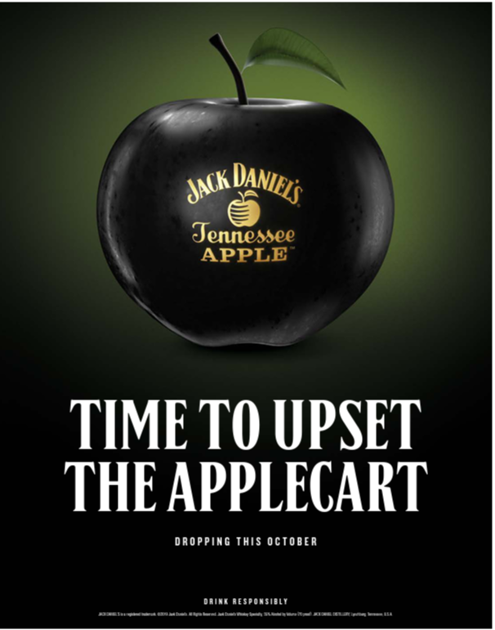
Role of the Product
Engage the Talent and the Consumer
Spark Fresh Conversation
Create Crisp, Refreshing Moments
Recognize Bold Moves
Notes:
Sabrina

Slide 8
Why Baseball?
Consumer Insights
Creating Better Brand Awareness
The Team's Hispanic Audience
Alcohol Presence at Sports Events
29% of People Who Favor The Dodgers and Marlins Are of Hispanic Descent (Morning Consult).
48% of Fans Drink at Sporting Events (Wired).
Sponsoring specific events that resonate with your target market creates "liking transfer" (Linkdex).
OVER INDEX AS FIRST TO TRY NEW
FOOD AND DRINKS
Notes:
Sab

Slide 9
Why Baseball?
Consumer Insights
The Miami Hispanic Audience
The Los Angeles Hispanic Audience
Alcohol Presence at Sports Events
49.1% Hispanic and Latino Population in Los Angeles County (US Census Bureau).
Targeting activations based around these Hispanic based cities will promote the product to the target audience in an authentic way.
69.1% Hispanic and Latino Population in Miami Dade County US Census Bureau
OVER INDEX AS FIRST TO TRY NEW
FOOD AND DRINKS
Notes:
Sab

Slide 10
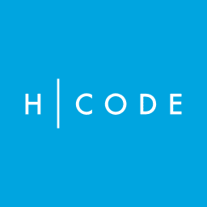
Media Partners Considered
Notes:
Sab

Slide 11
Recommended Media Partner
A Social Media Based Content Production Company for Sports Related Media
MultiChannel Activation
Across TikTok, Instagram, and YouTube (2.4 Billion Monthly Video Views)
Can Contract Athletic Talent That Resonates with the Target Demo
Notes:
Sab

Slide 12
[No Days Off] Previous Example
Player Breakdown with Gisselle Espinoza on YouTube
Mexican National Team Soccer Player
Insight About Her Life And Experiences
Sponsored by Cinnamon Toast Crunch
Shows Whistle's Targeting Capability With Hispanic/LatinX Market
Notes:
Sab

Slide 13
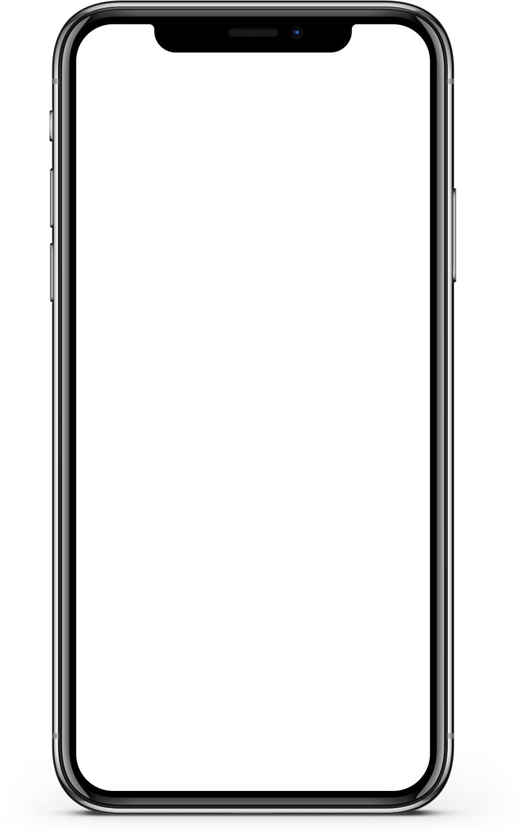
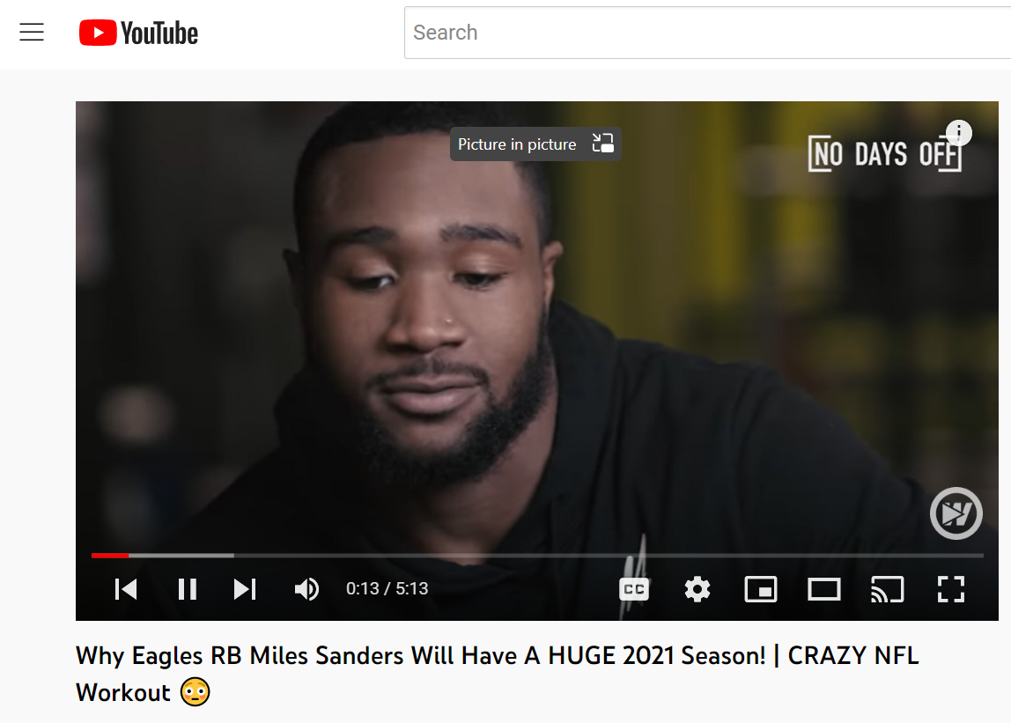
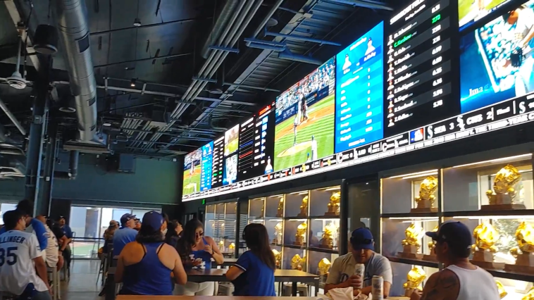
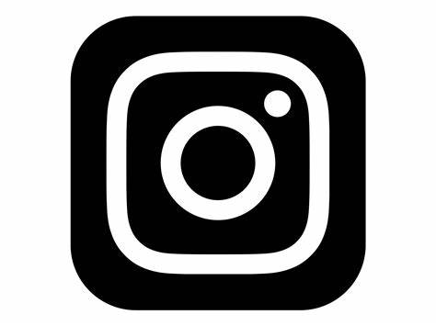
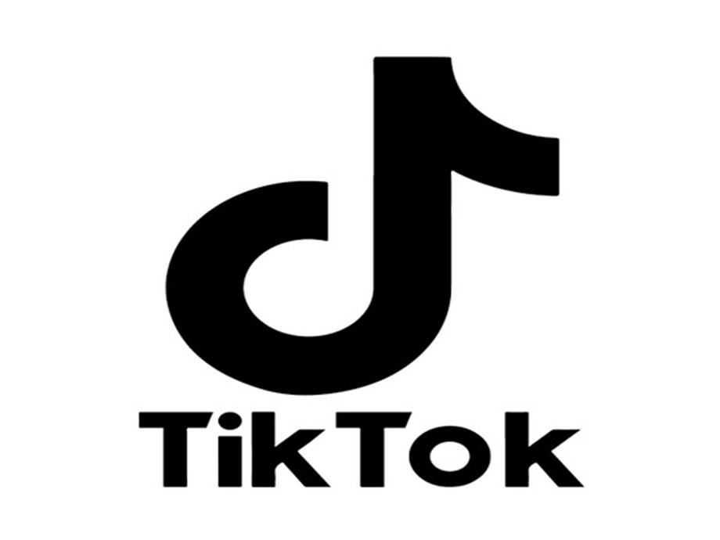
[No Days Off]: Baseball Edition Example Activation
2 x Long Form YouTube Content featuring Hispanic Baseball Players
Video follows the day to day of each of these baseball players in an exciting and engaging way
Clips of the players talking in their stadium bars about what their heritage means to them, with Jack Apple product placement.
Notes:
Sab

Slide 14
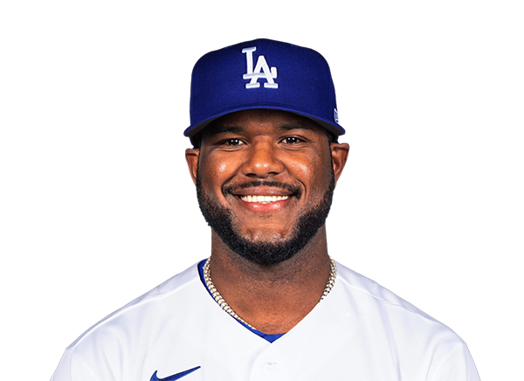
Meet the Influencers: Hanser Alberto
Professional Baseball player for the LA Dodgers
From the
Dominican Republic
Has an active Instagram following (54.7k followers)
17 career
home runs
Notes:
Sab

Slide 15
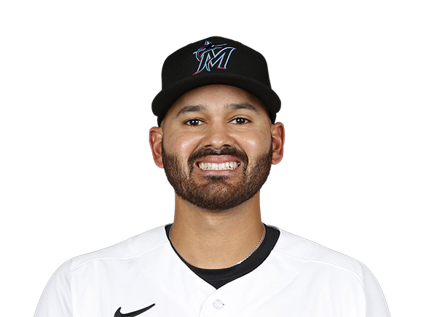
Meet the Influencers: Pablo Lopez
Pitcher for the Miami Marlins
From Cambias, Zula, Venezuela
Has an active Instagram that focuses on his sport and lifestyle (18.3k followers)
Played 82 baseball games in his career (and counting!)
Notes:
Sab

Slide 16
Example Questions For Players
"What is your favorite drink for a night out?"
"Jack Apple promotes living boldly, how do you live boldly?"
"What does your Hispanic heritage mean to you?"
"What made you want to be a professional baseball player?"
Notes:
Sab

Slide 17
Plus Up: Baseball Stadium Alcohol Example Activation
1
2
3
At each stadium there would be a drink that aligns with the cultural heritage of the Whistle Content baseball players.
1 Based from Venezuela in honor of Pablo Lopez
1 Based from the Dominican Republic in honor of Hanser Alberto
Short form social promotion for the drinks on Jack Daniels, Whistle, and Stadium's Snapchat, IG Reels.
Tie in with the [No Days Off] video, where players could make the drinks sold at the stadiums.
Notes:
Sab

Slide 18
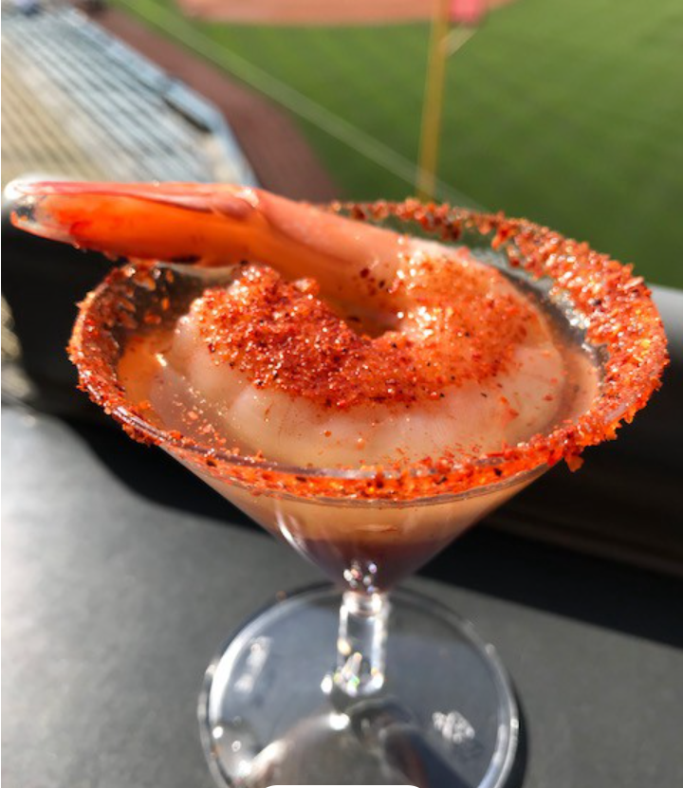
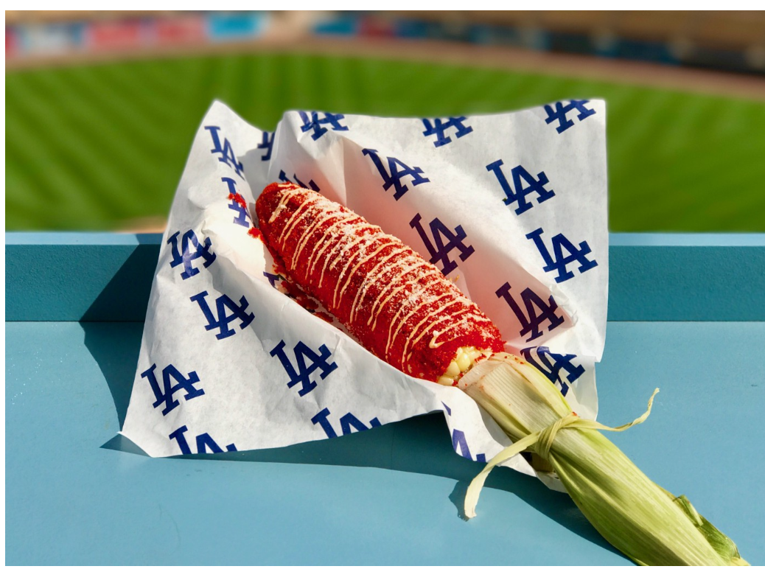
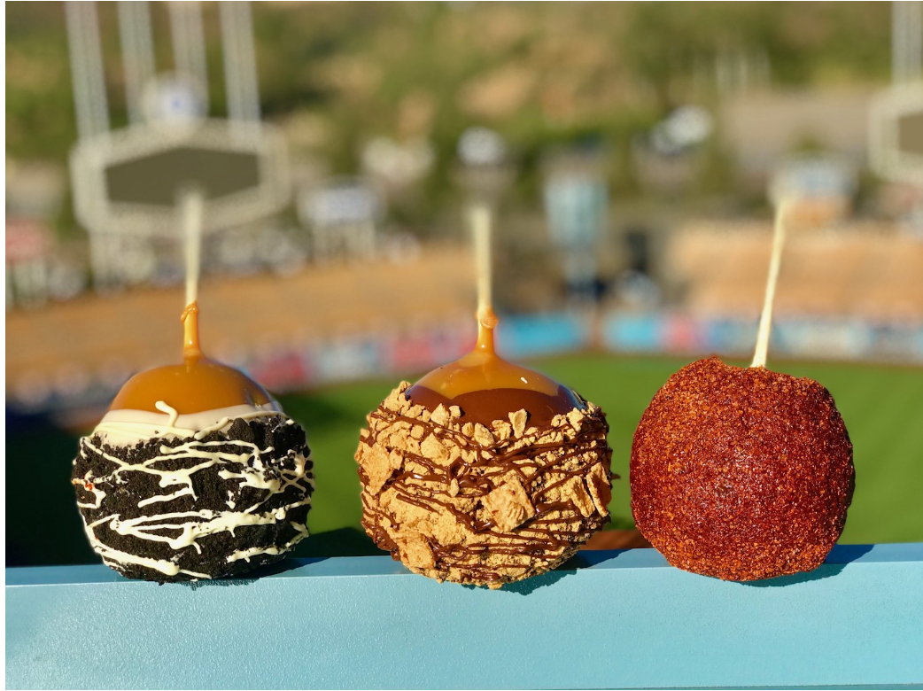
Plus Up Program Previous Examples
Dodger Stadium World Series 2018 Limited Edition Menu
Shrimp Shooter
Jumbo Shrimp in Michelada Mix with Don Julio Tequila
Cheet-o-Lote Corn
Corn made Elote style, covered in Hot Cheeto Dust
Caramel Apples with Oreos, Graham Crackers, and Chamoy
Dodger Stadium World Series food specials | by Rowan Kavner | Dodger Insider (mlblogs.com)
Notes:
Sab

Slide 19
Jack Apple Mamajuana
Mamajuana is a popular spiced alcoholic drink in the Dominican Republic.
It would be served spiked with Jack Apple at Dodger Stadium, during the campaign flight.
Notes:
Khalyn

Slide 20
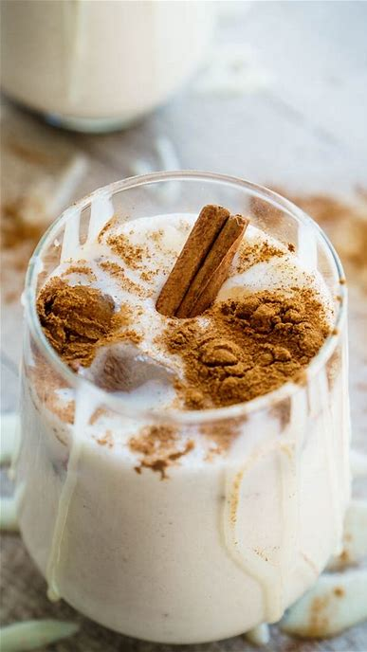
Jack Apple Chicha
Chicha is a popular rice, cinnamon drink in Venezuela, where Marlins Player Pablo Lopez is from.
Served spiked with Jack Apple at the Miami Marlin's stadium during the campaign flight.
Notes:
Khalyn

Slide 21
MEDIA PARTNERSHIP GOAL
Campaign Timeline
Week of 9/15
Mamajuana and Chicha Drink is introduced at both stadiums
Week of 9/22
Whistle Long Form YouTube Content Released with Hanser Alberto
Week of 9/29
Teaser Posts for Pablo Lopez's Long Form YouTube Video on Instagram and TikTok are released on Jack Daniels Socials
Week of 10/06
Whistle Long Form Content Released with Pablo Lopez
Short Form TikToks, Instagram on Jack Daniels Socials about Hanser Alberto's interview + drink at Dodger Stadium
Short Form TikToks, Instagram about Pablo Lopez's drink released throughout the week on Jack Daniel Socials
Short form teaser released on Instagram for Hanser Alberto's long form Youtube Video
*online social promotion for the Jack Apple drinks would continue throughout the entirety of the campaign flight
Notes:
Sab

Slide 22
Content Overview
Whistle Activation:
2 x Baseball Player "No Days Off" Videos with Whistle
4 x Instagram and TikTok posts for "No Days Off" (2 for each player)
Drink Plus Up:
2x custom drink served at player stadiums
2 x Custom Social Posts for the drink on the stadium's, Jack Daniel's, and Whistle IG Reels and Snapchat
Advertisement for the drink in-stadium
Notes:
Sab

Slide 23
MEDIA PARTNERSHIP GOAL
Budget Breakdown
Base Program
Whistle Video Sponsorship + Multi–Channel Social Media Promotion
$500k
Plus Up
Miami Marlins and LA Dodger Stadium Alcohol Sponsorship + Social Promotion for the Drink on Jack Daniels, Whistle, and Stadium Socials
$1,000,000
Notes:
Khalyn

Slide 24
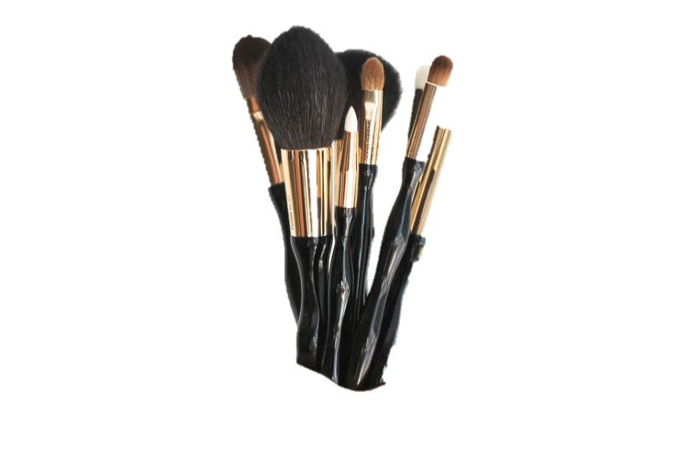
Campaign 2
BEAUTY INFLUENCER COLLAB
Notes:
Sam

Slide 25
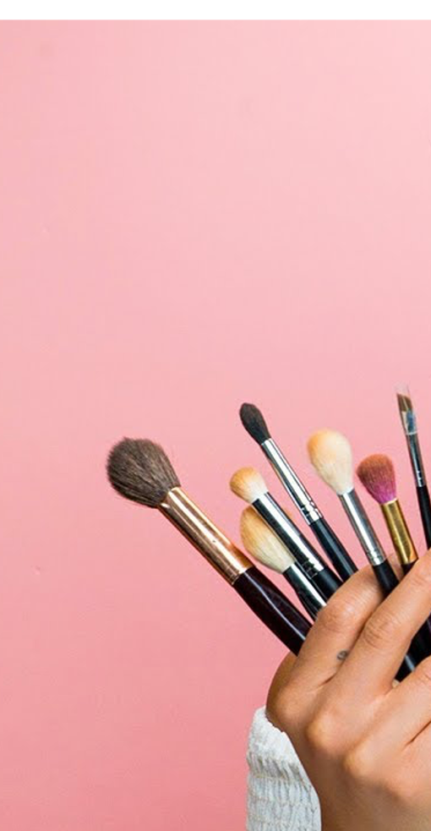
Beauty Influencer Collab Campaign
Makeup Influencer Video Partnership
Create a fun, authentic tipsy "Get Ready With Me" style video featuring 2 beauty influencers while sipping a class of Jack Apple with additional short form content for social
The Collab Relevancy
"Get Ready With Me" style videos are a staple in the beauty community
Proudly Hispanic influencers collaborating with a media channel that has a raw and fun tone
The Role of Jack Apple
The makeup look will be inspired by the green shades in Jack Apple
The perfect opportunity to mesh bold makeup and conversation during existing drinking moments
Notes:
Sam

Slide 26
Media Partners Considered
Notes:
Sam

Slide 27
Recommended Media Partner
A Magazine for Beauty, Fashion and Lifestyle Media
MultiChannel Activation Across TikTok, Instagram, and YouTube (3.5 Billion YouTube Views and 11.9 Million subscribers)
Has a playful pop culture feel that aligns with the influencers
Notes:
Sam

Slide 28
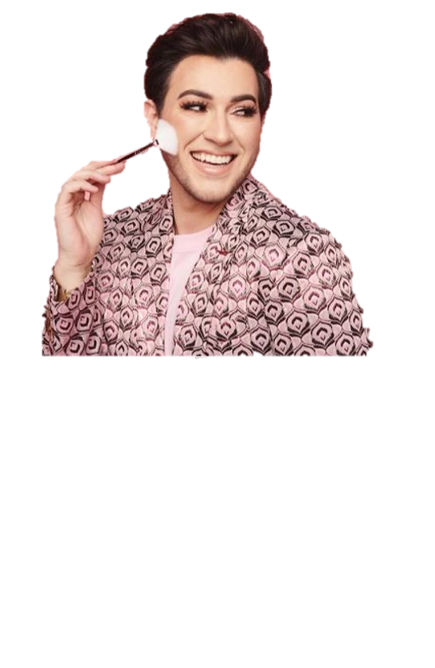
Meet the Influencers: Manny Gutierrez
Beauty Influencer & founder of Lunar Beauty
Mexican-American
Has active followings on Instagram (4.1M), TikTok (1.5M), and YouTube (4.86M) following
Very engaging, raw personality with a LatinX following
Notes:
Sab

Slide 29
Meet the Influencers: Desi Perkins
Beauty Influencer & founder of of DeziSkin
Mexican-American
Has an active Instagram (4.4 mil), TikTok (475.7k), and YouTube (3.27M) following
Personality is family-oriented and authentic
Notes:
K

Slide 30
Why Influencers?
Consumer Insights
Influencer Marketing Stat
Benchmark Report
GRWM
These videos allow influencers to review multiple products simultaneously, and users also get a sense of what the products are like and how they work.
l
63% of Hispanics say they have purchased cosmetic or beauty products in the past 6 months.
Marketing Charts
The Influencer Marketing Industry is set to reach 16.4B impressions in 2022.
Marketing Statistics
OVER INDEX AS FIRST TO TRY NEW
FOOD AND DRINKS
Notes:
https://www.marketingcharts.com/industries/cpg-and-fmcg-114751#:~:text=About%206%20in%2010%20(62,diversity%20in%20skin%20tone%20offerings.

Slide 31
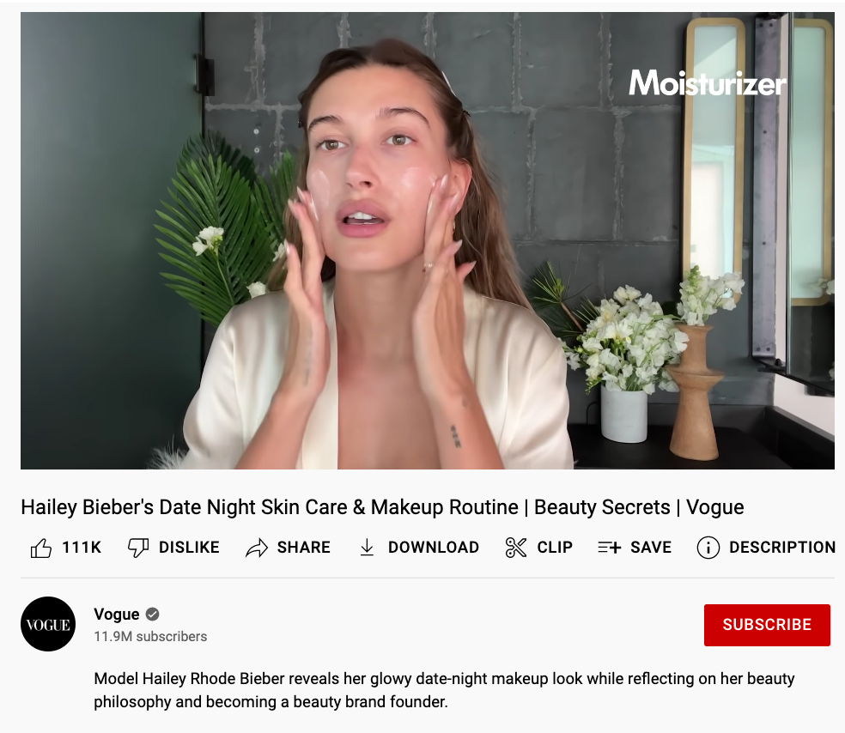
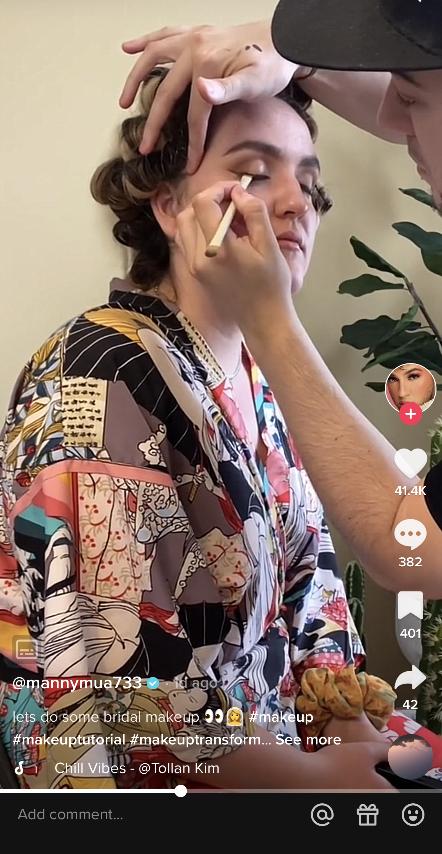
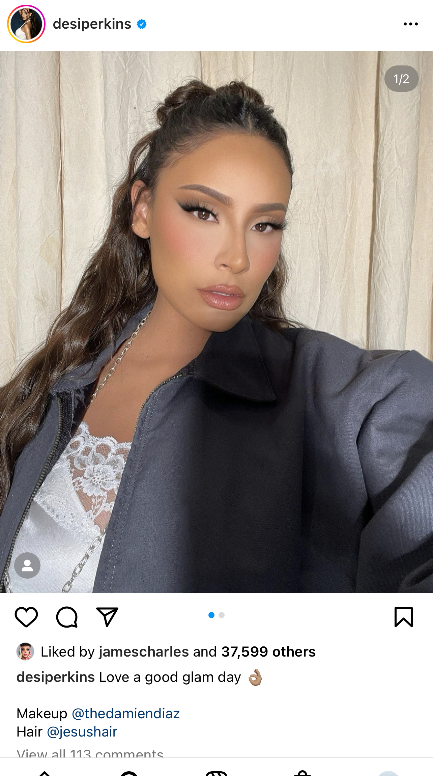
MEDIA PARTNERSHIP GOAL
Content Overview
1 Long-form Get Ready With Me YouTube video
1x Instagram reel
per creator
1x feed post on Instagram per creator
Notes:
Sab

Slide 32
Example Questions For Influencers
"What is your drink of choice while getting glam?"
"Jack Apple promotes living boldly, how do you live boldly?"
"What does your Hispanic heritage mean to you?"
"How does makeup help boost your confidence?"
Notes:
Sab

Slide 33
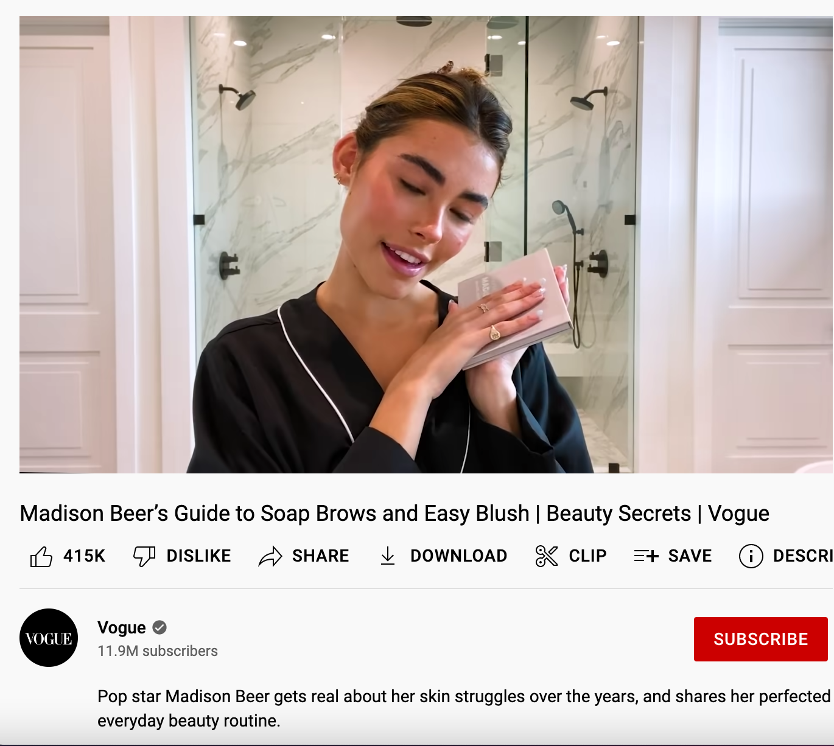
Example Activation #1
Vogue YouTube Video: Get Ready With Me ft. Jack Apple
Vogue Series: Beauty Secrets
Example:
12M views and 416K likes
She stayed authentic by opening up about skin issues
YouTube Description:
"Our favorites @desiperkins and @mannymua get ready together while discussing their Mexican-American heritages, CEO advice, and family traditions featuring Jack Apple from Jack Daniel's."
Notes:
Sam – connect with hispanic audience

Slide 34
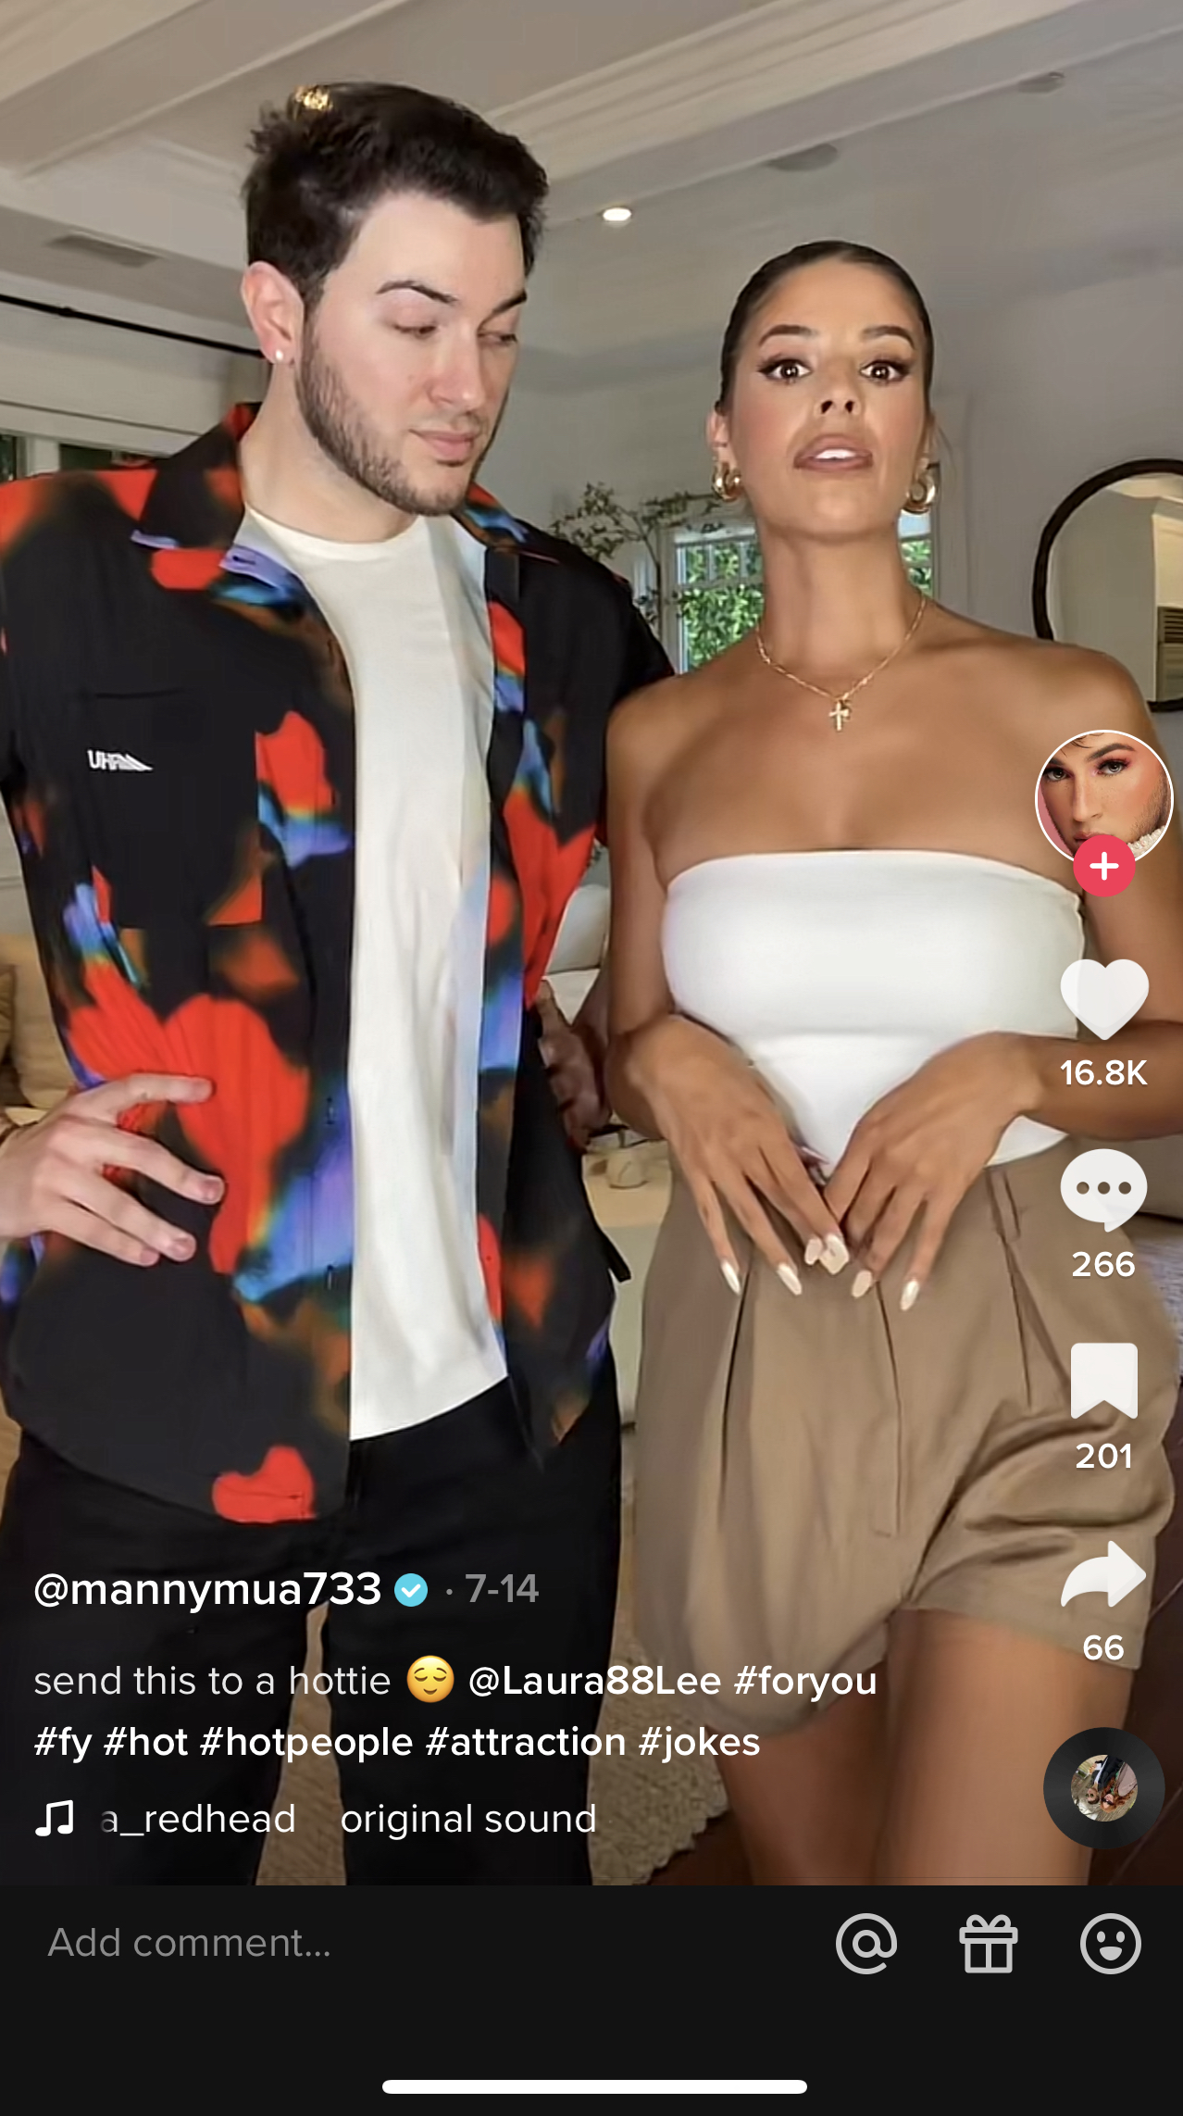
Example Activation #2
Instagram Short-form Content
Desi's Content
1x Behind the Scenes Reel on IG
1x Selfie on IG
Instagram Caption for Desi:
"Had the most fun time getting glam with @MannyMUA using @Jackdaniels_us Jack Apple as inspo for this look🍏🧚🏻‍♂️✨"
Manny's Content
1x Bloopers Reel on IG
1x Selfie on IG
Instagram Caption for Manny:
"Want to see me and @desiperkins laugh until we cry? Check out this bloopers reel from our @vogue @Jackdaniels_us Get Ready With Me featuring #JackApple 💚"
Notes:
Sam

Slide 35
MEDIA PARTNERSHIP GOAL
Campaign Timeline
Week of 9/15
Manny and Desi will film the longform and shotform content
Week of 9/22
"Get Ready With Me" Long Form YouTube Content released on Vogue with Manny and Desi
Week of 9/29
"Bloopers" video released on Vogue
Week of 10/06
Followed by day-of-shoot Instagram feed post
Short form teasers and selfies released on Vogue's media platforms
End of flight
Instagram reels posted
Week of 10/13
Notes:
K

Slide 36
MEDIA PARTNERSHIP GOAL
Budget Breakdown
Base Program
Vogue Video Sponsorship
2x Hero video
2x Social cut down ( 30 sec)
Negotiate post from Social Handle
$500K
Plus
Jack Apple Sponsor + Social Event
$750K
Notes:
K

Slide 37
Closing Thoughts
Main Goals for Both Campaigns​
How Our Recommendations Will be Effective
Focus on telling authentic stories with influencers who are known for their genuine content
Multichannel activations from influencers who have engaging audiences in their fields
Pick media partners who showcase talent similar to our target audience, who embrace Jack Apple values
Content on our selected media channels will reach the target demographic
Notes:
Khalyn
Talent industries - art, music, culinary, etc. Unique lens on other interests Jack has played with the past
Lens for bigger following talent, how is their job lending to macro storyline

Slide 38
THANK YOU!

